Slide 1

Twitter Sentiment analysis

Slide 2


Sentiment Analysis

Slide 3

Why Twitter ?

Slide 4
Objectives
To implement an algorithm for automatic classification of text into positive, negative or neutral.
Analyze Particular Subject
Analyze Particular Location Tweets
Analyze User Timeline

Slide 5
Steps for analysis
Data collection using Twitter API
Data Pre-processing
Data Cleaning
Applying classification algorithms
Sentiments in graphical representation
Hashtag Extraction

Slide 6
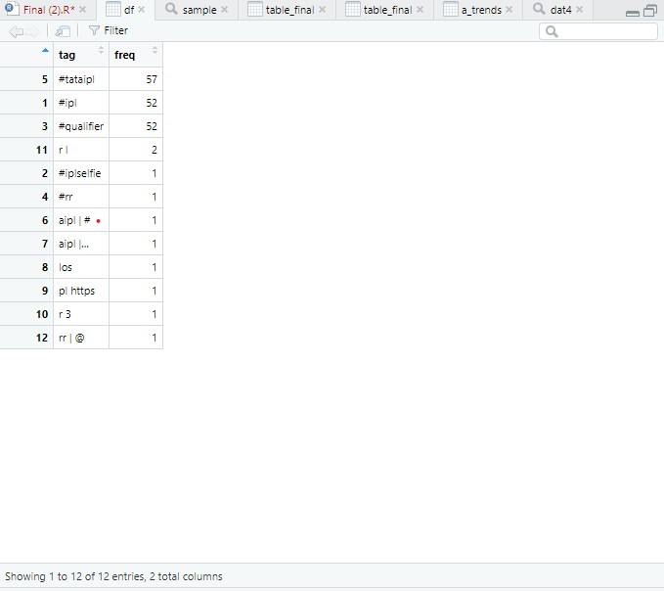
Data Frames
It is a table (or) a two dimensional array like structure in which each column contains values of one variables and each row contains and one set of values.
Using Pandas we are creating Data Frames

Slide 7
Technique used
Natural Language Processing (Lexical Analysis)

Slide 8
What is lexical analysis?
By comparing uni-grams to the pre-loaded word database, the tweet is assigned sentiment score-positive, negative or neutral and overall score is calculated. .
What is the purpose of lexical analysis?
It removes the punctuation, comma's, white spaces and also decimal values.

Slide 9
Example:
“Petrol price in India is reduced by 9.5 rupees”. But why?
Petrol price in India is reduced by 9 rupees but why

Slide 10
Steps for analysis:
list=lapply(sentences, function(sample, Pos_Words, Neg_Words)
Removed unnessary content.
Done the matching.
Stored score, positive and negative in the form of list.
Reshaping and merging is done.

Slide 11
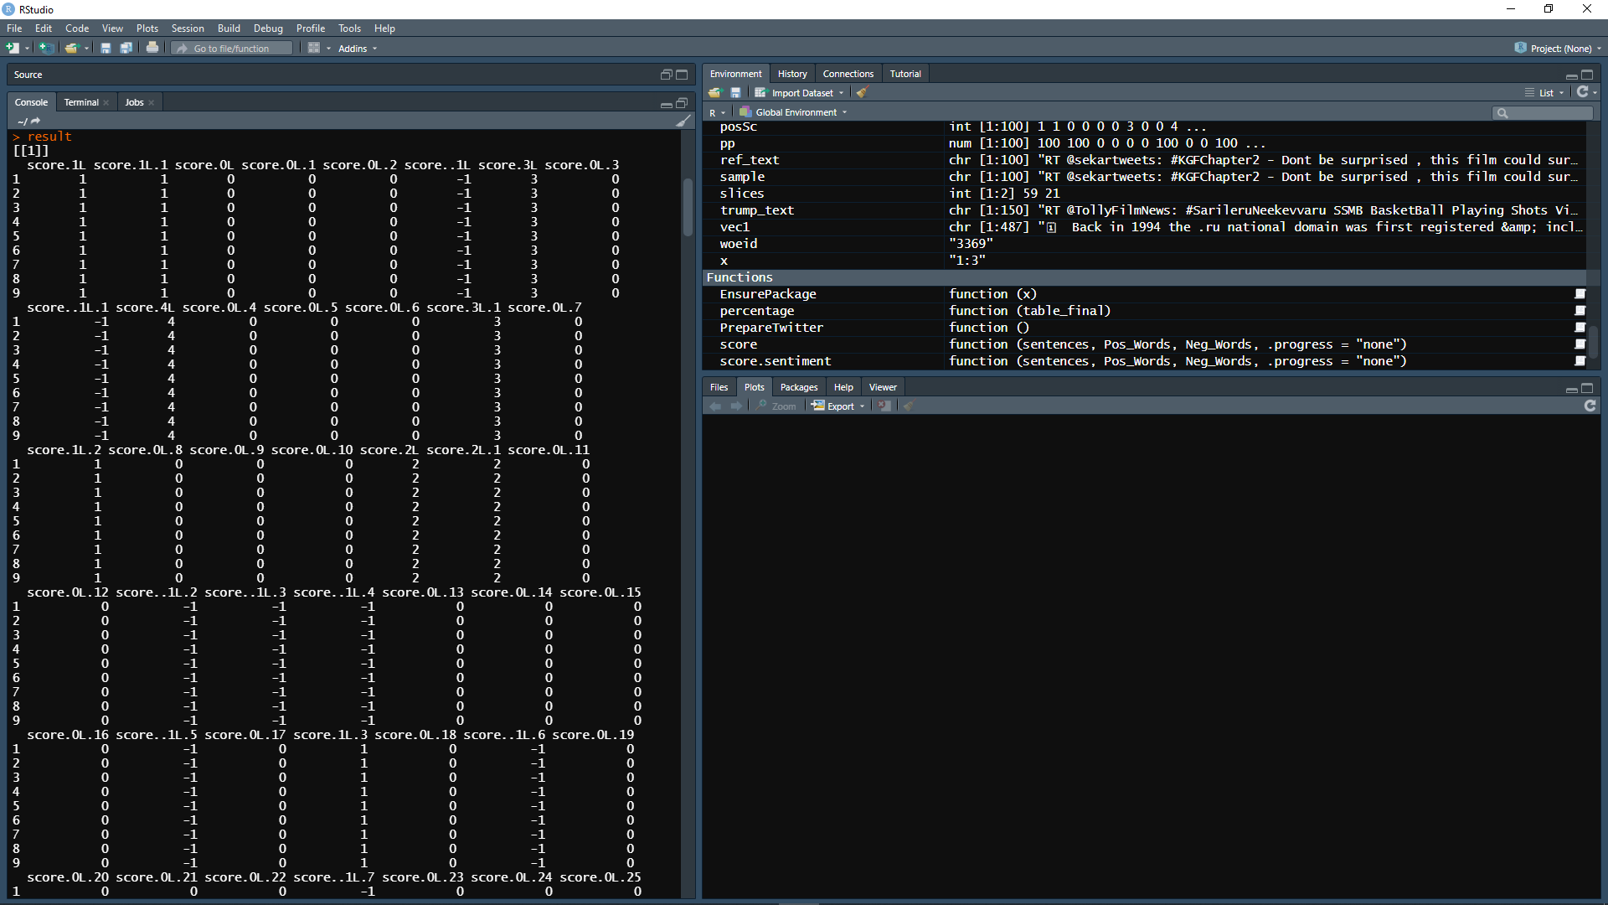

Slide 12
Steps for analysis:
To simplify this we will firstly , we remove the text and store one whole text in one place.
Then we melt the score , postivite and negative.
Now we create the data frame.
Then we merge the data frame.

Slide 13
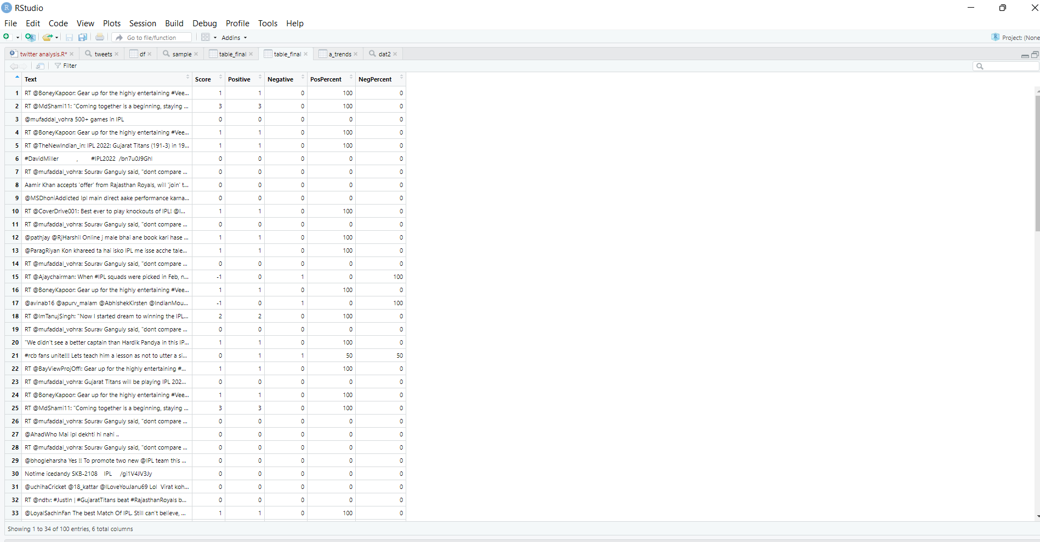
Final table.

Slide 14
Packages
Plyr- it is used to split the data apart.
Stringr- The stringr package provide a cohesive set of functions designed to make working with strings as easy as possible.

Slide 15
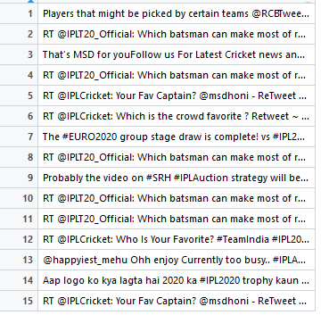
Sentiment Analysis of Hashtag ( #IPL )

Slide 16
Word cloud
A word cloud is a visual representation of text data, typically used to depict key word meta data (tags) on websites, or to visualize free form text.
This format is useful for quickly perceiving the most prominent terms and for locating a term alphabetically.

Slide 17
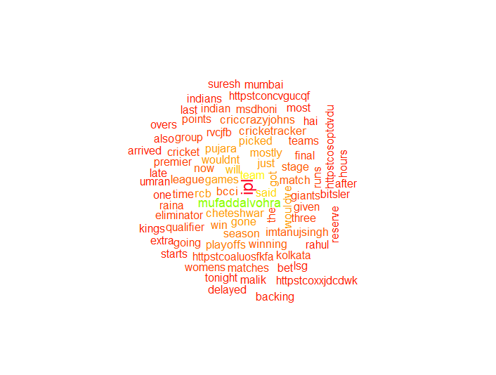
Word Cloud

Slide 18
Ggplot
The ggplot displays the most popular hashtags on Twitter, as well as their frequency.
Histograms of positive, negative and overall score are found under the Histogram tab for graphically analyzing the intensity of emotion in the tweeters.
The frequency of values of a variable bucketed into ranges is represented by a histogram.
The distinction between a histogram and a bar chart is that a histogram arranges values into continuous ranges.
R creates histogram using hist() function.

Slide 19
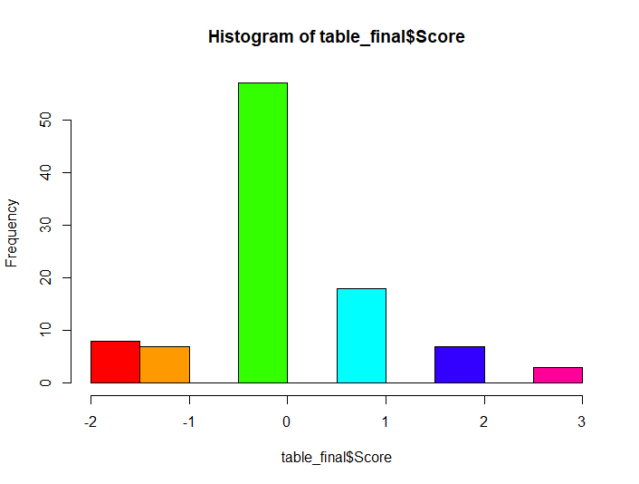
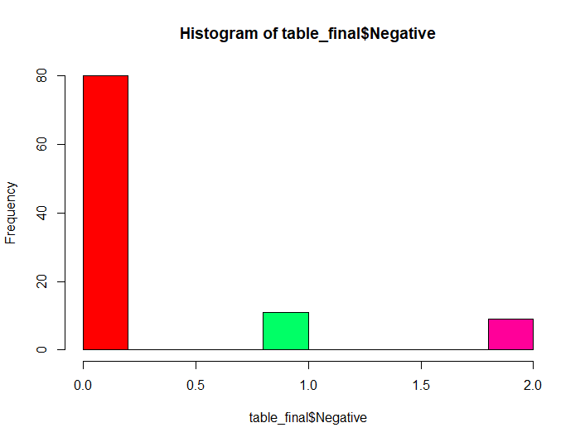
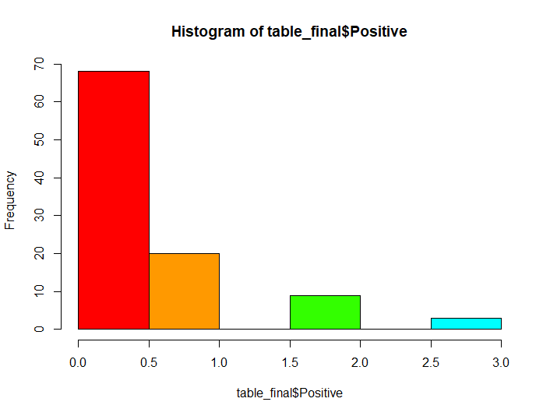

Slide 20
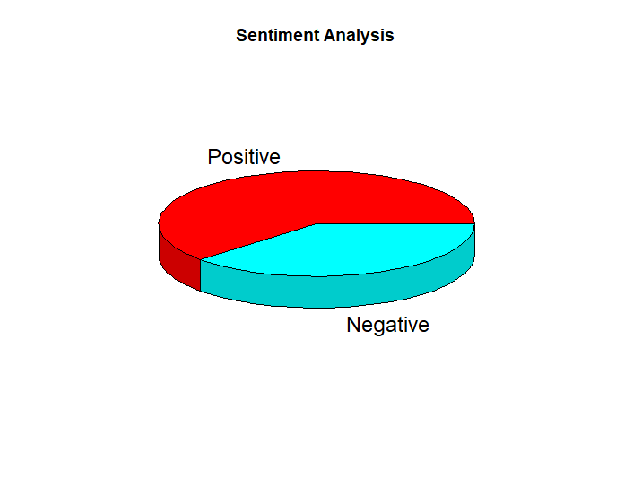
PIE CHART
A pie chart is a circular statistics image that is broken into slices to depict hashtag sentiment.
The arc length of each slice in a pie chart is proportionate to the quantity it shows.

Slide 21
Types Of Applications
1. By Location
We can find top trends according to location of a place .
Each country is given a Woeid , commonly known as a World Id to uniquely identify the country or a place In a country.
By using this Woeid, we extract the top trending tweets ,display and classify them.

Slide 22
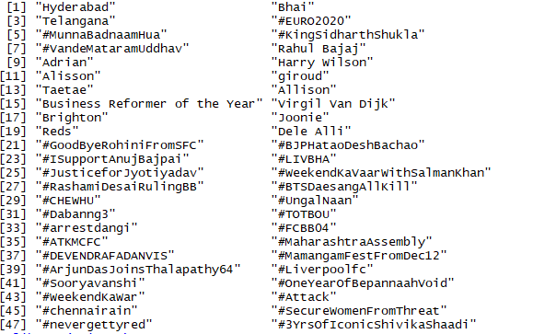
Location Trends ( Hyderabad )

Slide 23
2. By User
Here in this second type we can retrieve the top 10 hashtags of a particular user.
We use the timeline function and consider n number of tweets (100<n<2000) for selection.
The result will be accurate as we consider many tweets but will also be slower as it requires time to process many tweets.
These two techniques help us to gather trending events and tweets of a celebrity or a particular user.

Slide 24
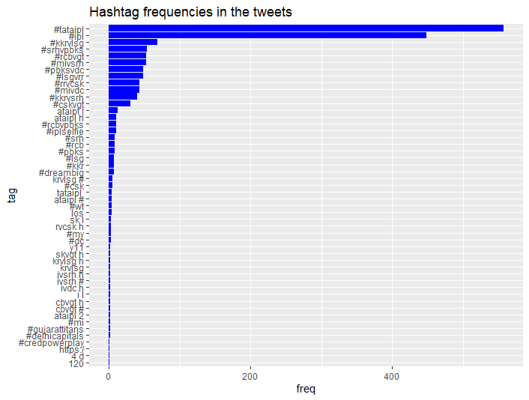

Slide 25
Limitations
The Twitter Search API can get tweets up to a maximum of 7 days old.
Not effective in detecting sarcasm.
Cannot get 100% efficiency in analysing sentiment of tweets.
Can only retrieve a maximum of 1000 tweets per query without authenticating via OAuth before receiving a 403 error or timeout.

Slide 26



